Slide 1
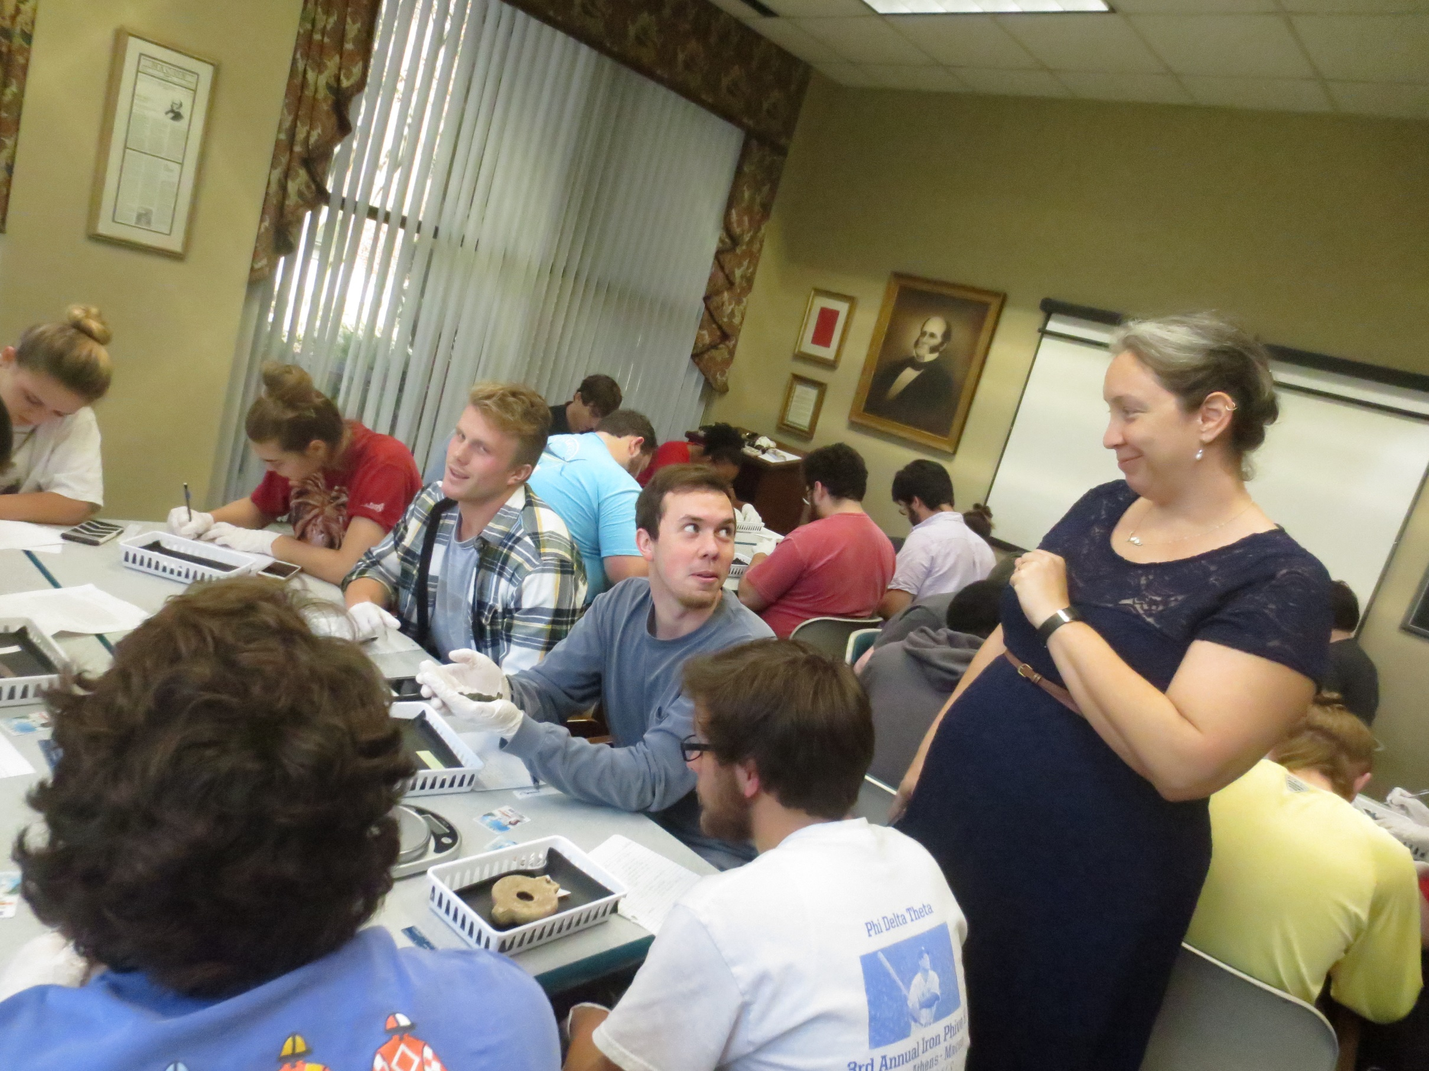
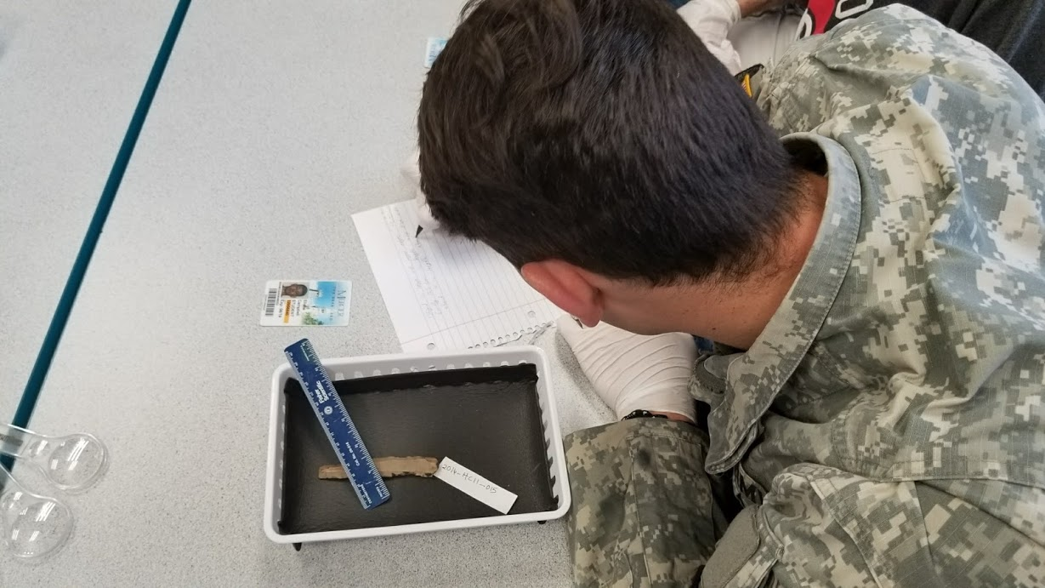
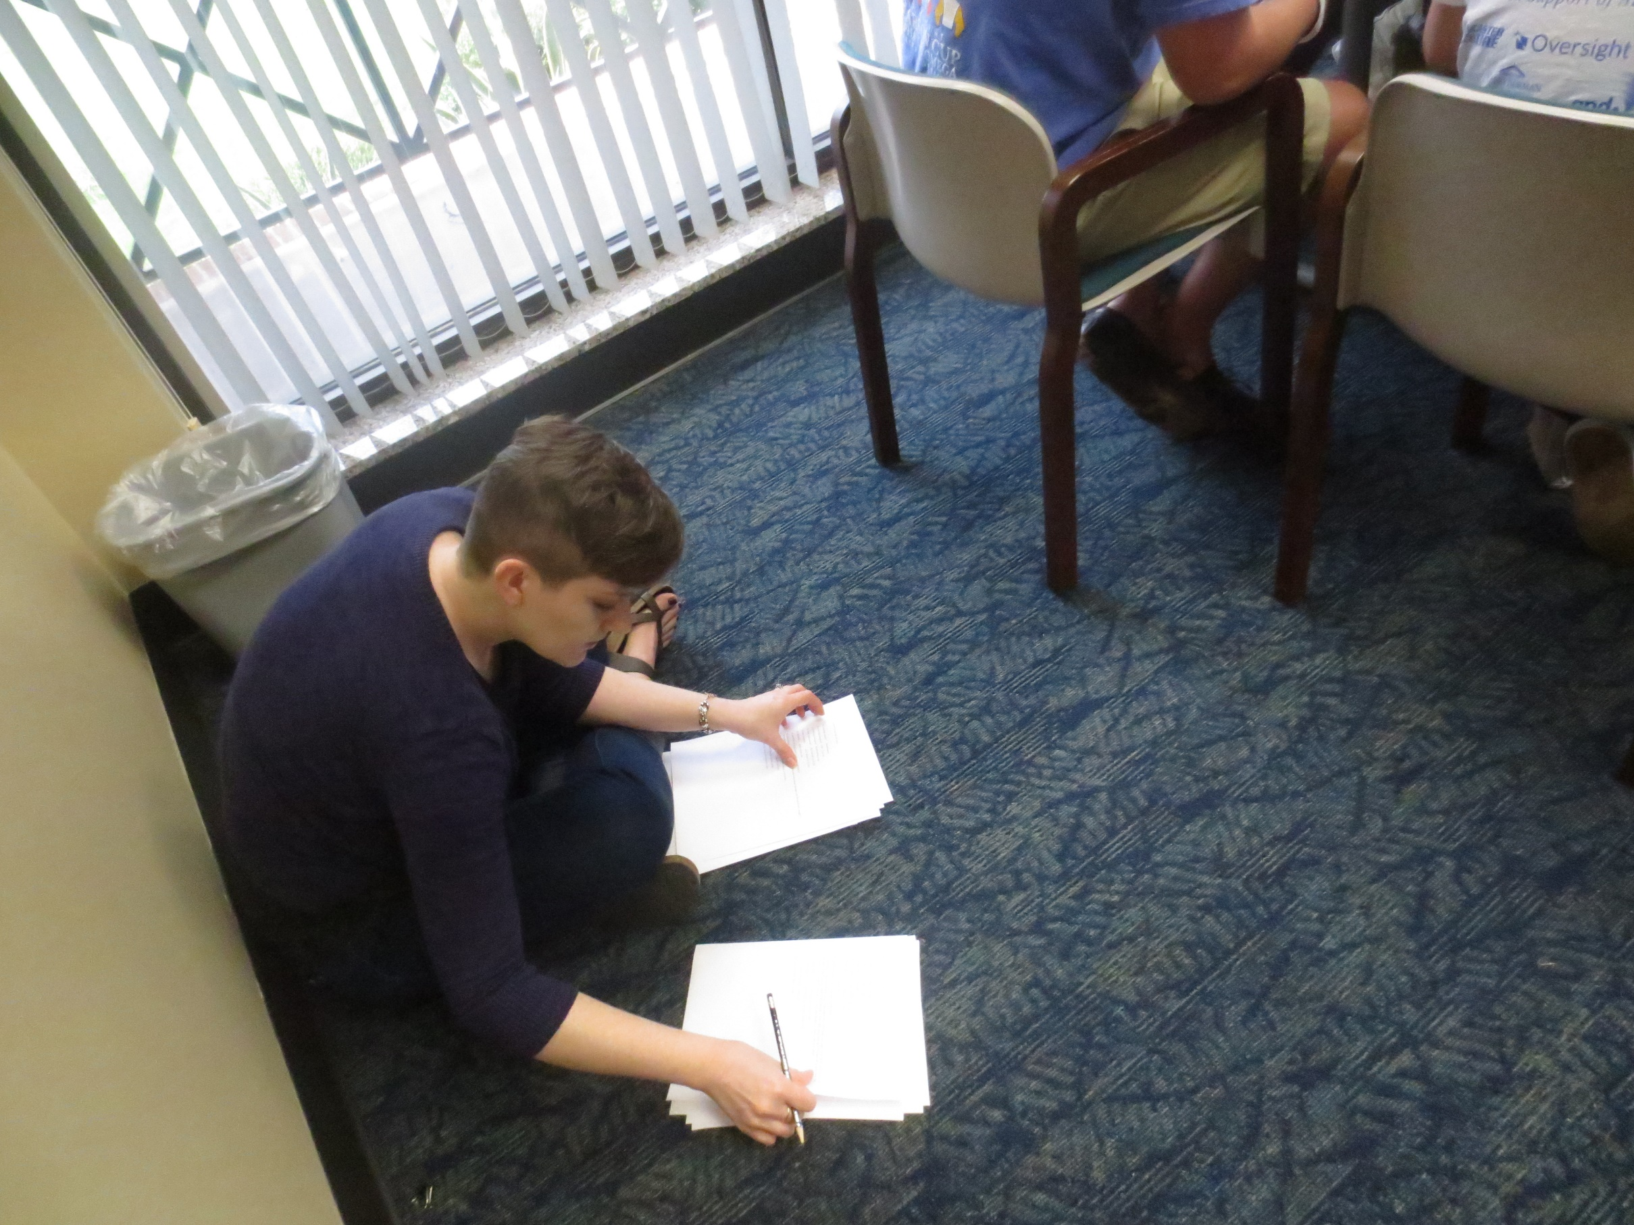
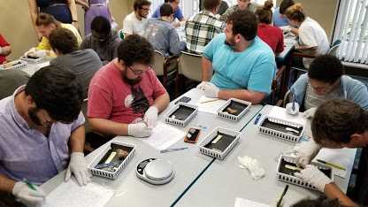
“Can I Really Touch It?” Antiquities in the Hands of History Undergraduates
Kathryn B. Wright, Archivist Kristen Bailey, Librarian Abigail Dowling, Professor
Problem Statement
In 2016, Y. Lynn Holmes gifted the Mercer University Library a collection of Near Eastern and Mediterranean antiquities amounting to nearly 800 pieces and another 200-some objects in 2017. The Holmes Collection was donated expressly for use as a teaching collection. It consists of coins, figurines, oil lamps, beads, tiles, pitchers, and other daily living items consisting of ceramic, metal, glass, and stone. Most of the items are small and stable enough to be reasonably handled by individuals in a classroom setting. Physically holding these objects creates an analytical connection that viewing photos of them would not. Dowling wished for her students to have hands-on experience with period-created objects, and Bailey and Wright feel that student use of this Holmes Ancient Objects Collection to interact with history facilitates outstanding information literacy education
tl;dr: There's a bunch of really old stuff donated to us. We'd like to use it for something. A faculty member wanted students to handle this antiquities collection to feel more connected to history research.
Research Approach
The Michael C. Carlos Museum at Emory University shared their guidelines for handling and collections request form. These were utilized as the basis for our policy. SAA's Guidelines for Primary Source Literacy and ACRL'S (Association of College and Research Libraries) framework for information literacy were both foundational for the instruction design.
tl;dr: We did not re-invent the wheel.
Results
The course included two progressive projects that involved the student in each step of the historical process for the antiquities from identification to analysis. The first two-part assignment relied heavily on the Tarver Library’s Holmes Collection and faculty. Bailey and Wright co-taught two sessions for the project. The first was an instructional session on library resources, primary and secondary sources, how to handle historical objects, and writing thick historical descriptions. SLOs were designed in conjunction with the ACRL'S (Association of College and Research Libraries) framework for information literacy. Primarily that students, "acknowledge they are developing their own authoritative voices in a particular area and recognize the responsibilities this entails..."
The second session was a 75-minute hands-on workshop with the Holmes objects to allow the students to investigate their assigned object. The goal of both sessions was to gather sufficient information to write thick descriptions for dissemination to their peers. The items were selected based on stability, durability, and size. Artifact prep and deployment included:
placed in Volara foam-lined 5" x 8" x 2" Sterilite plastic baskets
A slip of paper with the object identifier was placed in the corner of the basket
Each student workstation had one artifact basket and pair of nitrile gloves
Upon arrival, students placed their belongings in a separate, secure location except for:
student identification card
cell phone
pencil and
paper
As the students began working, the archivist walked around and took a photo of each student’s workstation with the object, object identifier, and student ID together. This assisted in recording the condition of the items at the beginning of the assignment, as well as tracked which student received which item. While these tasks were performed, the research services librarian monitored the students and items. The students were encouraged to take photos as personal prompts and for the final descriptions but were not allowed to hold their phones over the items to prevent dropping of said phones.
The first assignment involved students drafting a thick description of objects. The goal was to describe their object in immense detail with no analysis or interpretation of the object, so that another scholar could use it to make interpretations. They were then assigned an object of their own, for which they drafted and thoroughly edited a short thick description (250 to 350 words).
For the second portion of the assignment, Dowling distributed the anonymized, revised descriptions to different students. With only these thick descriptions, students then researched and drafted short historical analyses of the objects and their originating culture using the library’s holdings. For both stages, Dowling distributed simultaneous written and verbal guidelines. For the first assignment, the students were repeatedly encouraged to avoid any interpretation or analysis until the second assignment in the project.
tl;dr: Nothing stolen or broken. The undergraduates learned stuff and enjoyed the assignment.

